Slide 1

Module 6 Software Test Plan
David Winter Software Development 1 CEN-3024C 2/14/2025

Slide 2
Introduction
A document detailing the strategy, scope and schedule for testing activities in software development.
It serves as a roadmap for testing, specifying what will be tested along with success criteria and how testing will be conducted.
Helps to identify issues early.
Provides clarity and direction for the team.
Sets clear testing goals and criteria to ensure the product meets the requirements.
Contributes to delivering a reliable product that will increase user satisfaction and trust.

Slide 3
Objective
Phase 1: Layout the foundational testing methodology for the entire business logic
Phase 2: Test for bugs, add missing features, stage development for phase 3
Phase 3: Follow the methodology set in phase 1 to test phase 3 GUI event handling
Phase 4: Integration testing for database environment, and styling the GUI to meet product visual expectation

Slide 4

Phase 1 Core Business Logic Testing

Slide 5
Main Menu
Login
Prompt for Username/Email, Password
Register
Prompt for Username/Email, Password, Account Type
Exit program

Slide 6
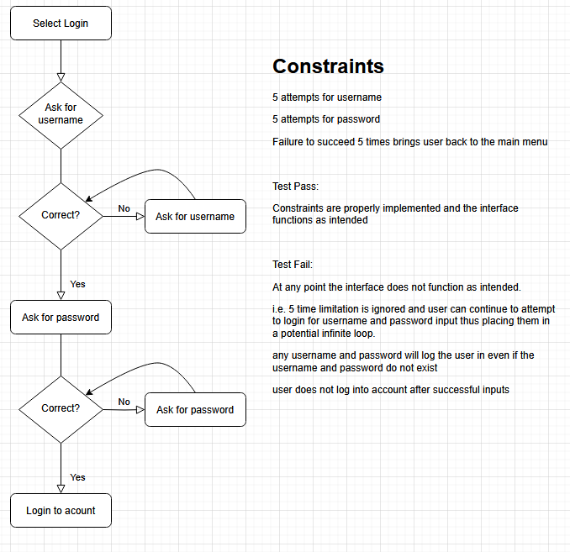

Slide 7
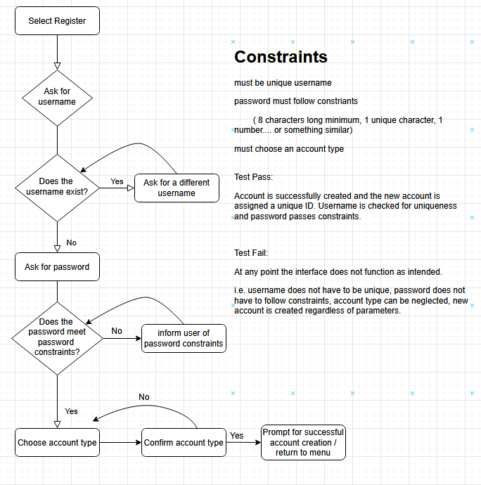

Slide 8
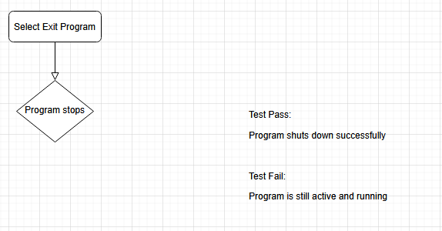

Slide 9
User Main Menu
Brows Selection
Reservations
Account
Logout

Slide 10
Brows Selection
List all vehicles
Reserve vehicle by ID
*note a list of vehicles should automatically appear when this is selected, and the user should first be asked to select an ID of the vehicle they want to reserve before entering the pickup and dropoff dates.
Enter pickup date
Enter dropoff date
Confirm Reservation (Y / N)
Return to previous menu

Slide 11
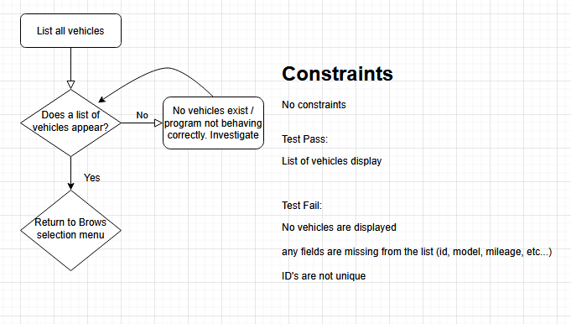

Slide 12
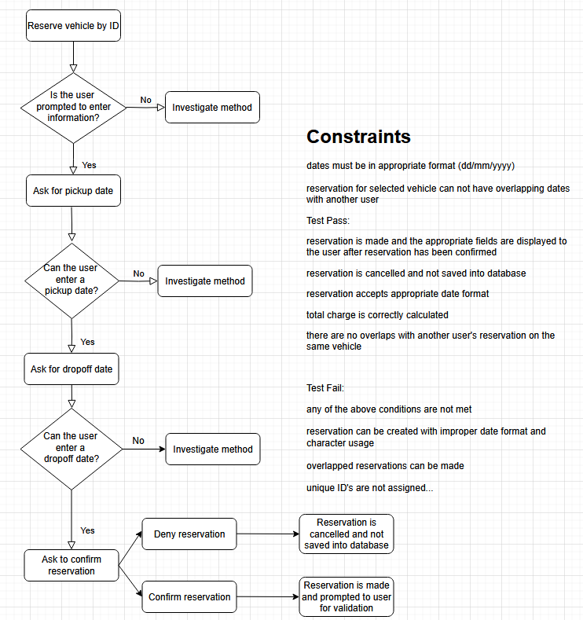

Slide 13
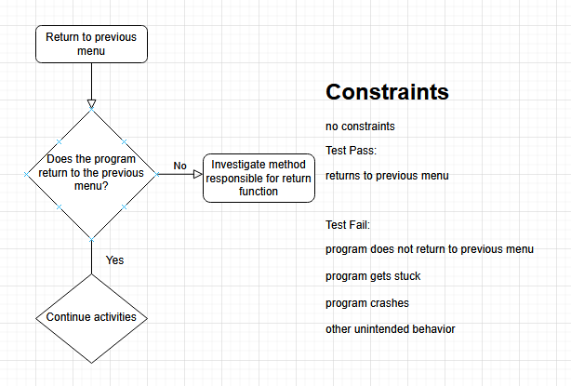

Slide 14
Reservations
View reserved vehicles
Cancel reservation by ID
Return to previous menu

Slide 15
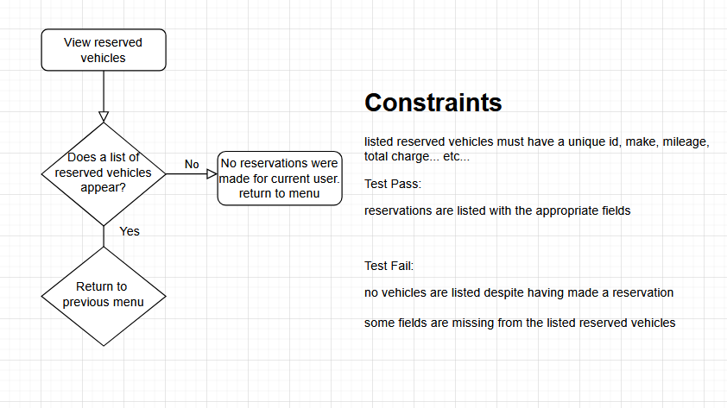

Slide 16
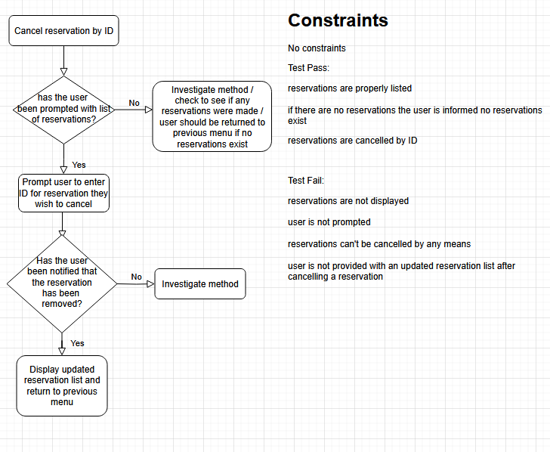

Slide 18
Account
View account details
Edit account information
Change email
Change first name
Change last name
Change password
Return to previous menu
Delete account
Return to previous menu

Slide 19
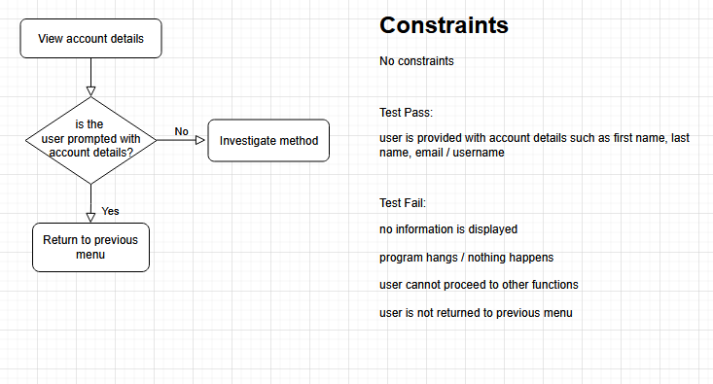

Slide 20
Edit Account Information
Change email
Change first name
Change last name
Change password
Return to previous menu

Slide 21
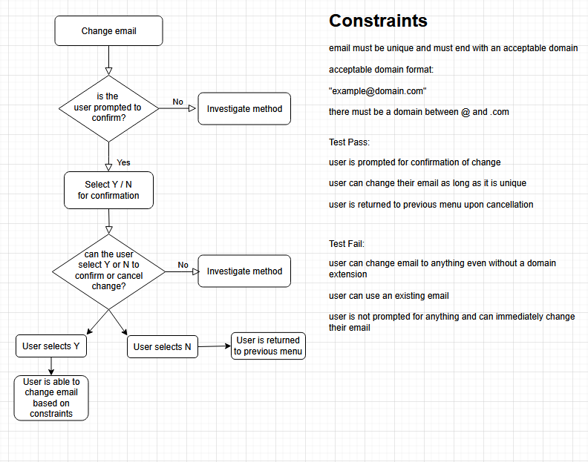

Slide 22
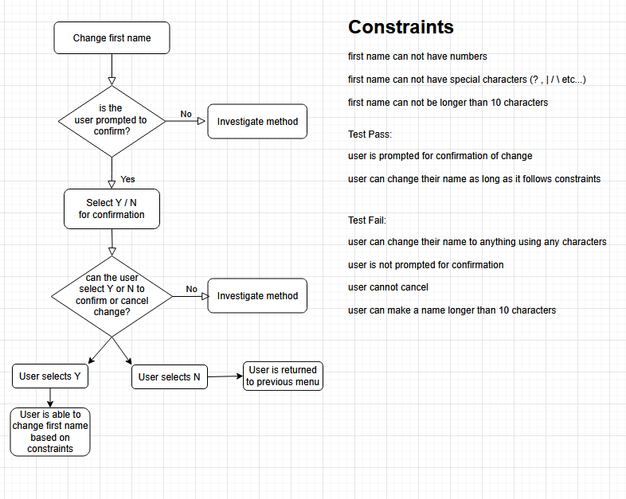

Slide 23
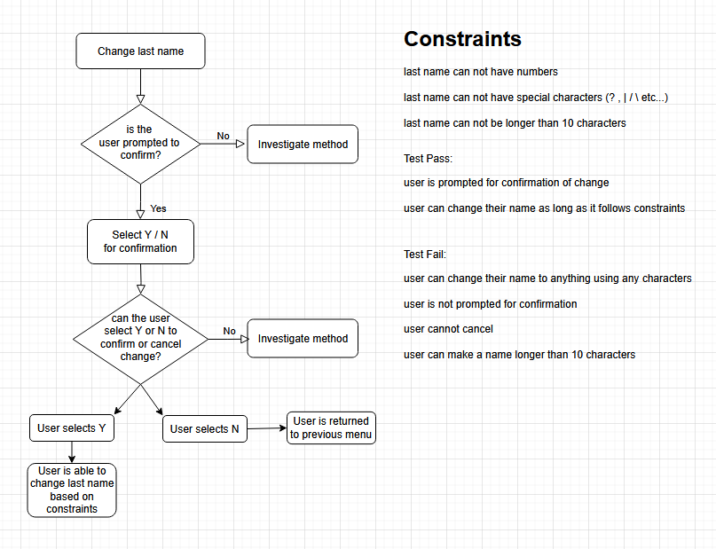

Slide 24
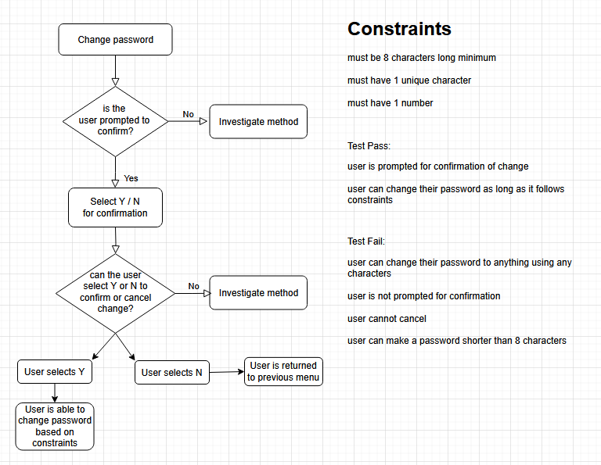

Slide 26
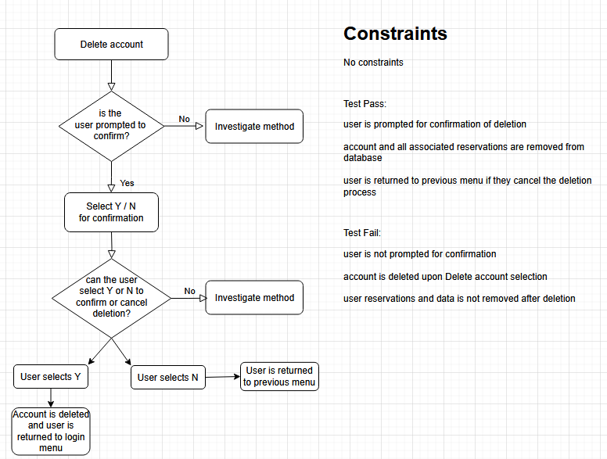

Slide 28
Admin Main Menu
Vehicle List
Users
Reservations
Account
Logout

Slide 29
Vehicle List
View all vehicles
Add vehicle
Upload .txt document
Manual input
Prompt for Type, Model, Year, Milage, Price Per Day
Return to previous menu
Return to previous menu

Slide 30
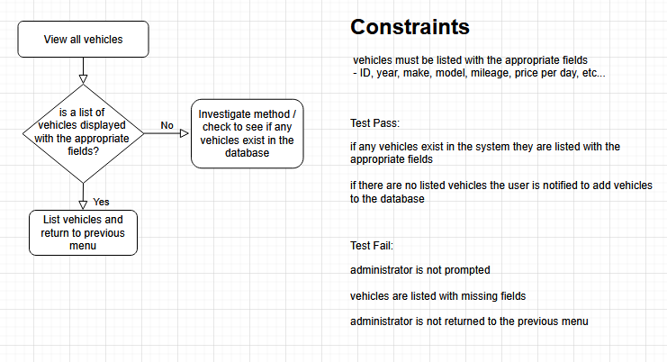

Slide 31
Add vehicle
Upload .txt document
Manual input
Prompt for Type, Model, Year, Milage, Price Per Day
Return to previous menu

Slide 32
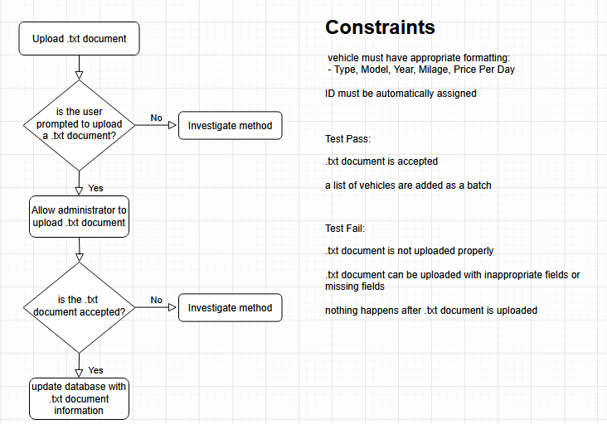

Slide 33
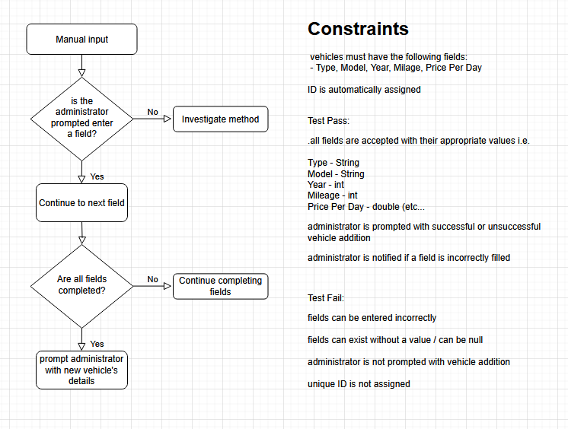

Slide 36
Users
View all users
Add users
Upload .txt document
Manual input
Prompt for First Name, Last Name, Email, Password, Account Type
Return to previous menu
Return to previous menu

Slide 37
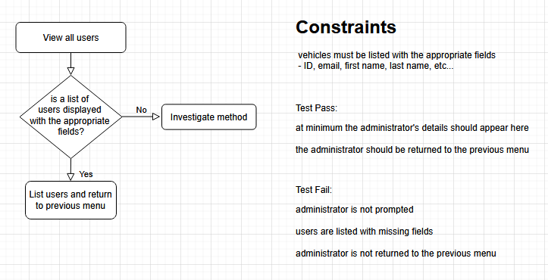

Slide 38
Add Users
Upload .txt document
Manual input
Prompt for First Name, Last Name, Email, Password, Account Type
Return to previous menu

Slide 39


Slide 40
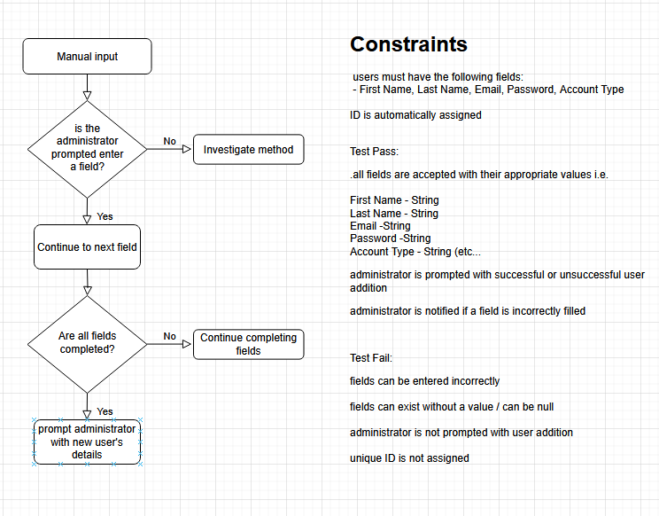

Slide 43
Reservations
View all reservations
Add reservation
Upload .txt document
Manual input
Prompt for UserID, VehicleID, Pickup Date, Dropoff Date
Return to previous menu
Delete reservation by ID
Return to previous menu

Slide 44
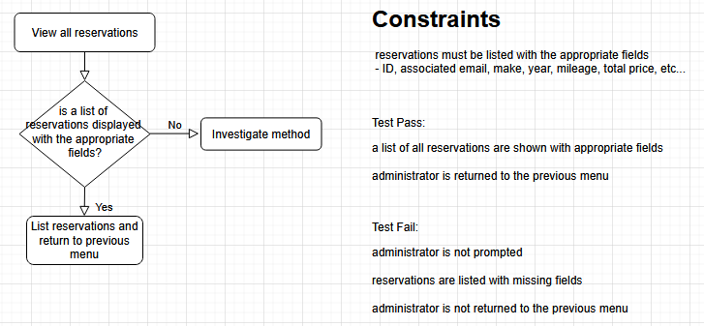

Slide 45
Add Reservation
Upload .txt document
Manual input
Prompt for UserID, VehicleID, Pickup Date, Dropoff Date
Return to previous menu

Slide 46
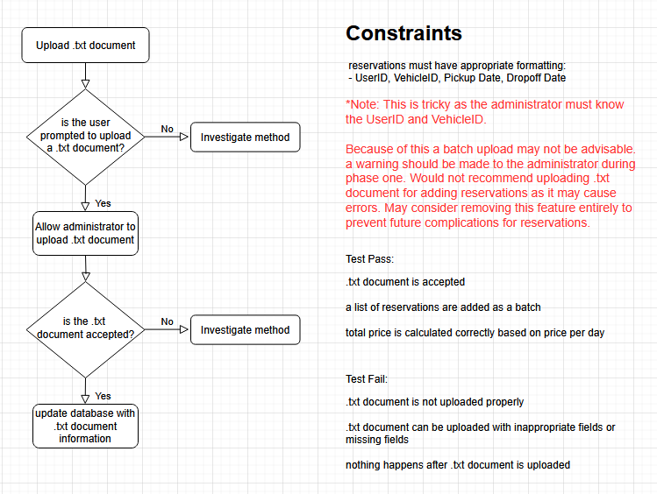

Slide 47
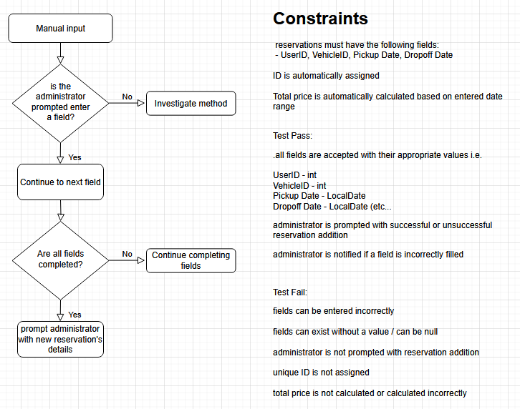

Slide 50
Account
View account details
Edit account information
Change email
Change first name
Change last name
Change password
Return to previous menu
Delete account
Return to previous menu

Slide 52
Edit Account Information
Change email
Change first name
Change last name
Change password
Return to previous menu

Slide 60

Phase 2 Validating Business Logic Staging for Phase 3

Slide 61
Objectives
Complete missing features
Test interface from Phase 1 for validation
Stage for Phase 3

Slide 62
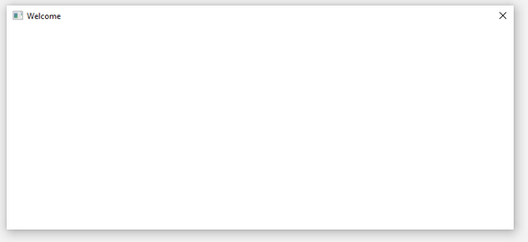
Goals
Set up JavaFX
Ensure a Jar file is executable, and an empty window is displayed upon execution without any GUI elements
Begin Phase 3 early if possible

Slide 63

Phase 3 Event Handling GUI Element Placement

Slide 64
Objectives
Take an iterative modular approach to building the GUI
Ensure all elements are placed relative to the GUI mockup
Refer to Phase 1 for interface testing
Implement Phase 1 logic into the GUI
Ensure the users and administrators do not need to interact with the console at this stage

Slide 65
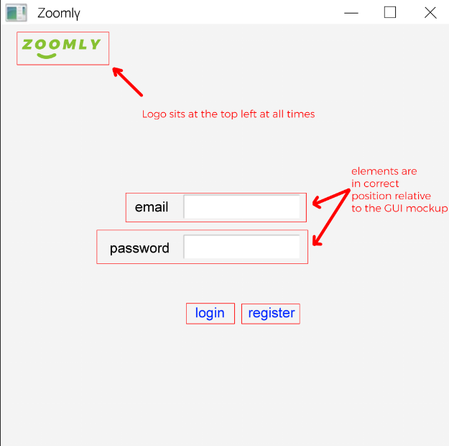

Slide 66
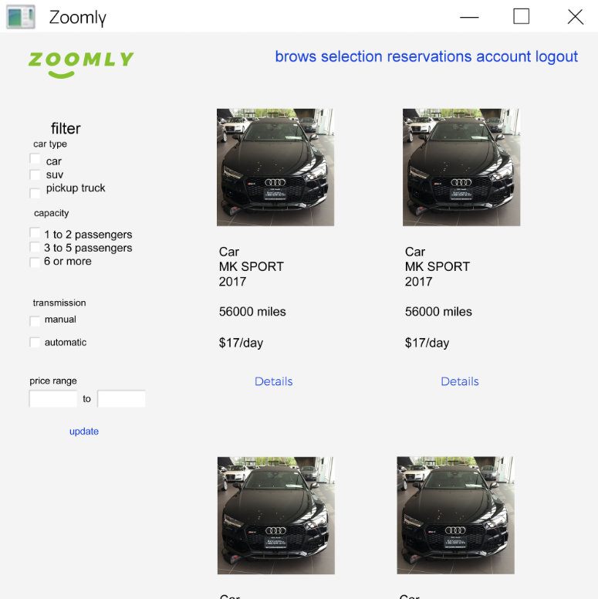

Slide 67
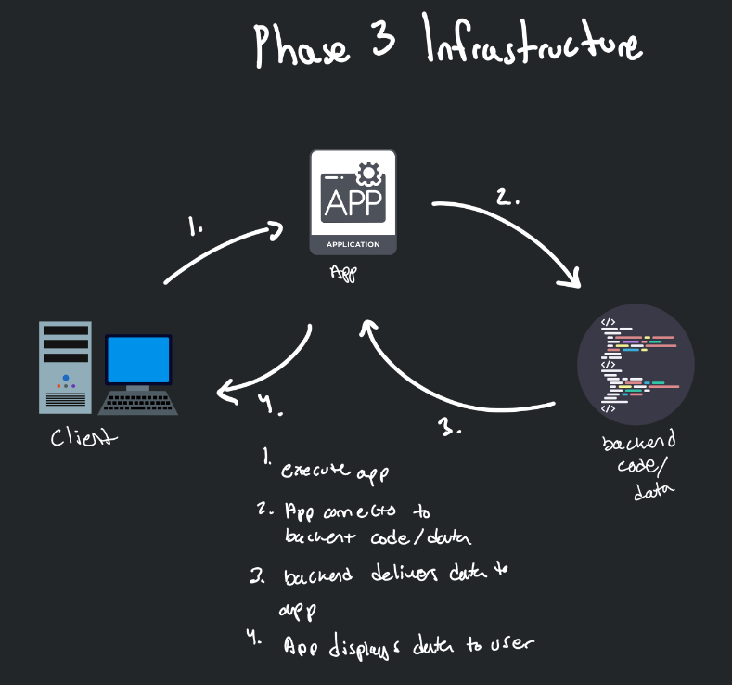

Slide 68
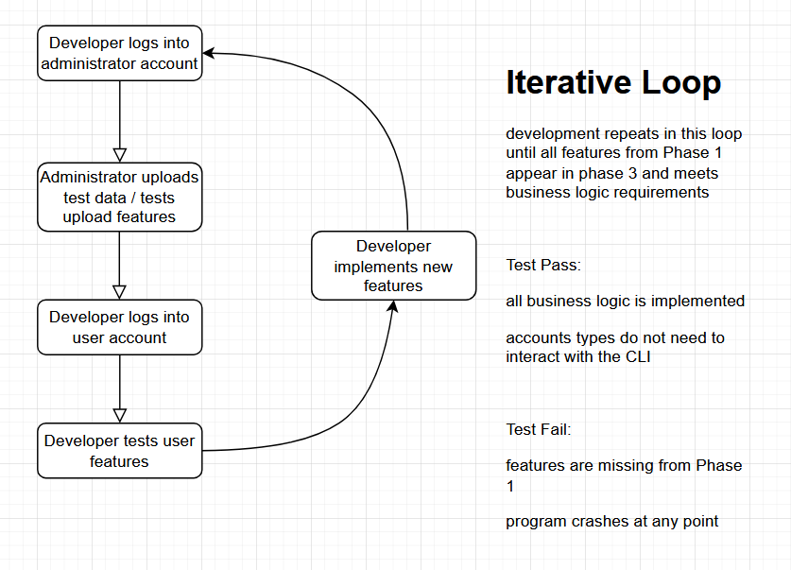

Slide 69

Phase 4 Database Integration Testing GUI Styling and Visual Appeal

Slide 70
Objectives
Create the DBMS
Connect the DBMS using JDBC
Refactor code to integrate with the DBMS
Refer to Phase 1 for testing logic
Add additional testing logic for filters and DBMS update features
Test for integration
Style GUI according to mockup *Done last*
Prioritize MVP functionality

Slide 71
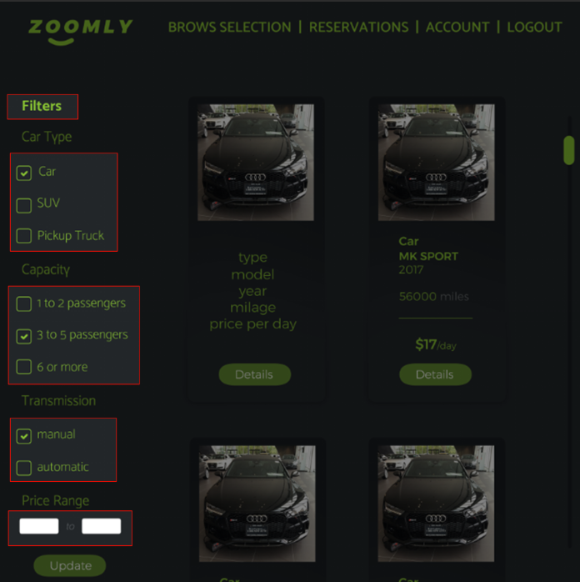

Slide 72
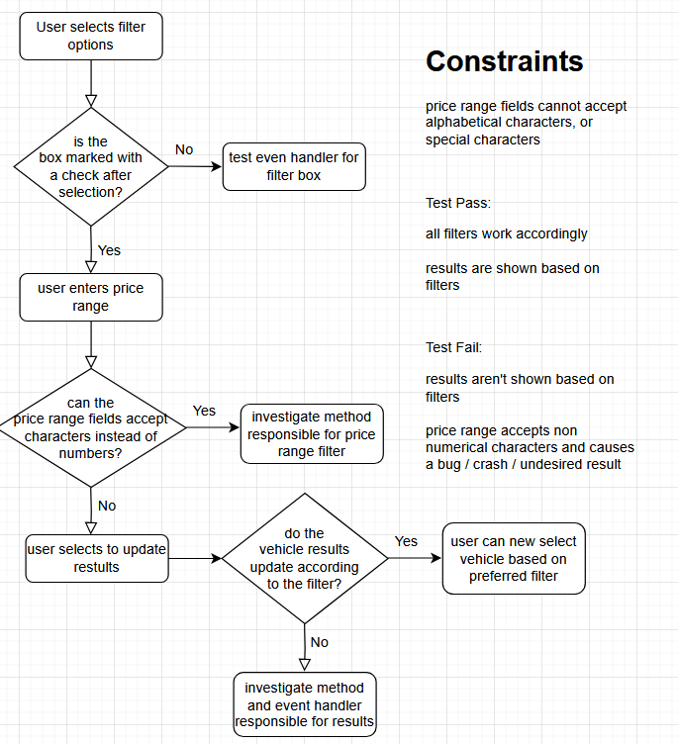

Slide 73
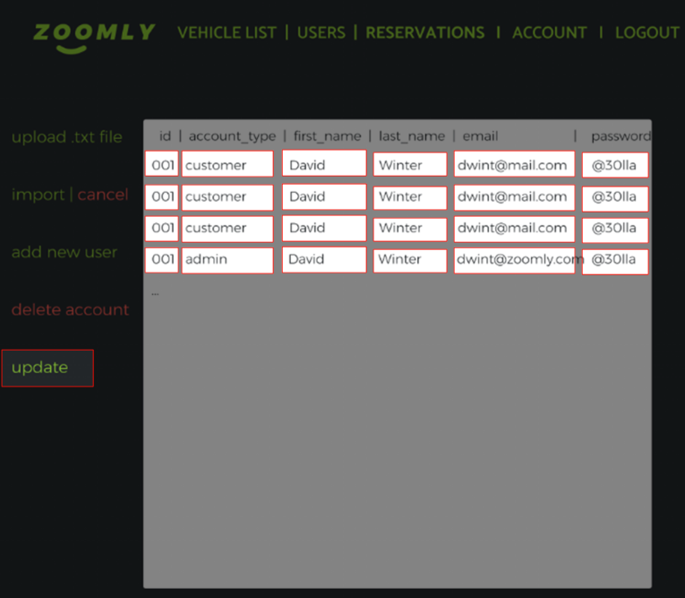

Slide 74
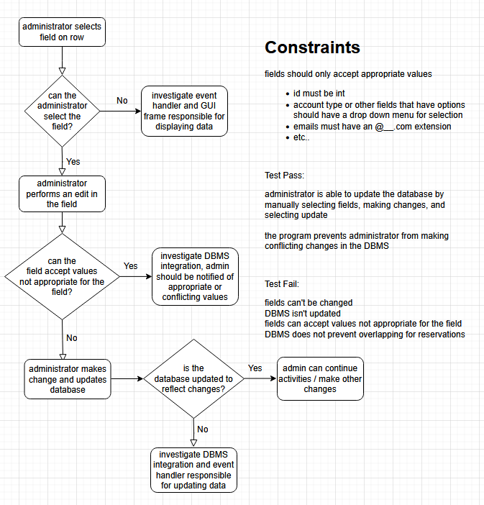

Slide 75
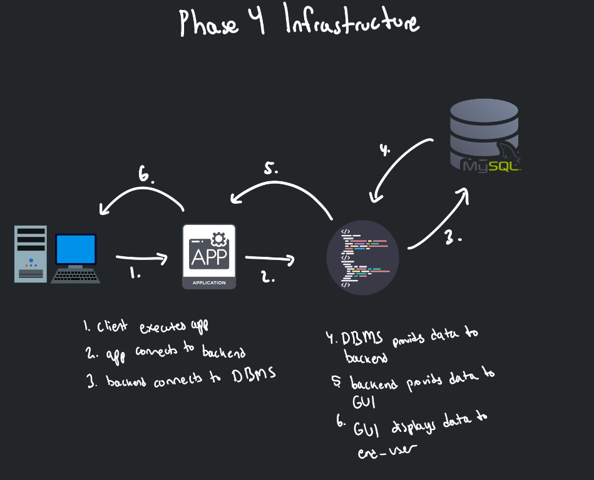

Slide 76
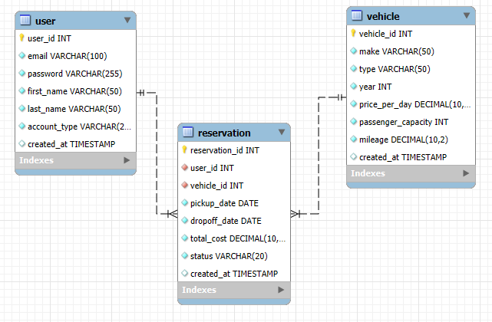
User to Reservation: One-to-Many (A user can make multiple reservations).
Vehicle to Reservation: One-to-Many (A vehicle can be reserved multiple times).

Slide 77

THANK YOU
For your attention!

